Slide 1
Learning to be Poetic: Automatic Generation of Chinese Song Ci
Nan Du, Wei Wang, and Zhuangdi Zhu
Michigan State University
Apr. 24, 2017

Slide 2
Background
Ci(词): A poetic form, originally means ‘lyric’.
Fixed number of Chinese characters
A rhyme scheme of level and oblique tones
In form of “long and short sentences”
Cipai(词牌): Cipai is the title of tune patterns that determined the number of characters in each line and the arrangement of tone.
Notes:
Ci: In early times, Ci are required to be arranged with music and to be sung, so there are some constrains on the format of Ci
Cipai: There are around 800 set of patterns, each associated with a particular title. Therefore, it’s common for several ci to share the same title.

Slide 3
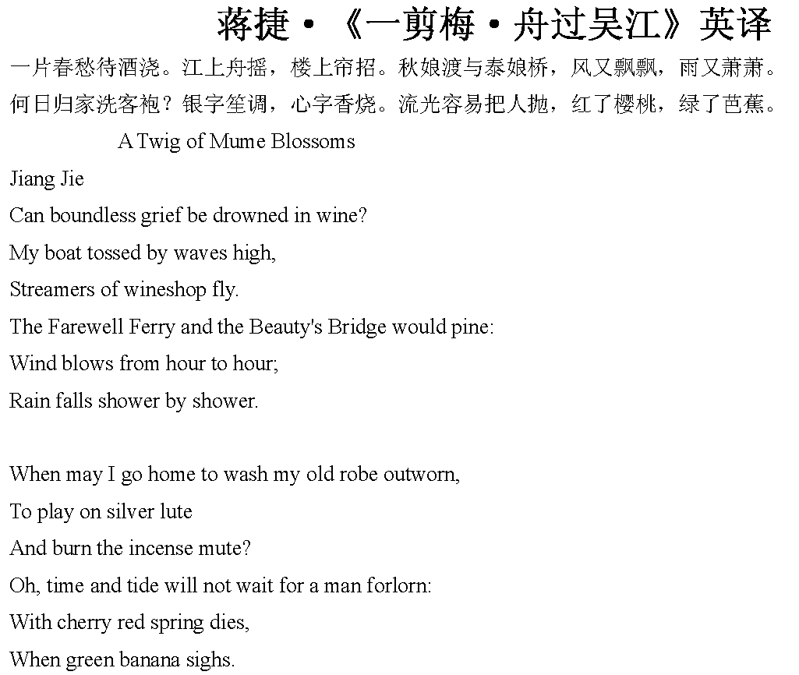
Background
Notes:
Ci: In early times, Ci are required to be arranged with music and to be sung, so there are some constrains on the format of Ci
Cipai: There are around 800 set of patterns, each associated with a particular title. Therefore, it’s common for several ci to share the same title.

Slide 4
Dataset
Dataset: Quan Song Ci(全宋词)
Character and Word:
Pingze(平仄): 1, 2
Rhythm: 24 rhythm
Correlation: word2vec
Cipai:
Sentence Format and Pingze:
Huanxisha(浣溪沙): ['0201021', '0102211', '0102211', '0201122', '0102211', '0102211']
Delimiter Format:
Huanxisha(浣溪沙): [ ， 。 。| ， 。 。]
Poet_Num | Poem_Num | Cipai_Num | Sentences_Num | Ave_Sentence_Length
1346 | 18986 | 929 | 268341 | 4.88
Notes:
Pingze is represent two type of tunes.

Slide 5
Approaches
Approaches
Traditional
Genetic Algorithm
Machine Learning
Recurrent Neural Network
Generative Adversarial Networks

Slide 6
Approaches
Approaches
Traditional
Genetic Algorithm
Machine Learning
Recurrent Neural Network
Generative Adversarial Networks

Slide 7
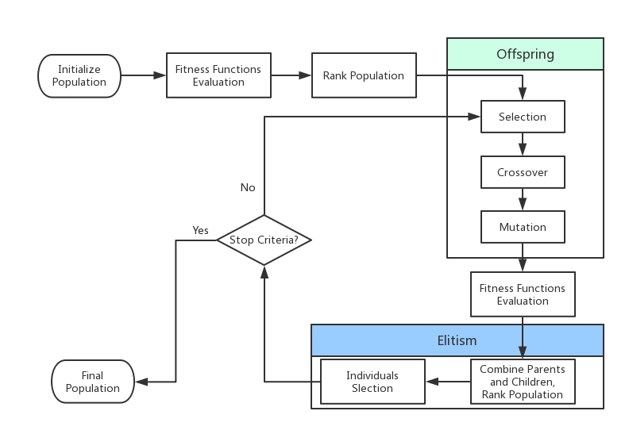
Genetic Algorithm
Changle Zhou, Wei You, Xiaojun Ding. “Genetic Algorithm and Implementation of Automatically Songci Generation.” (2010)
Notes:
GA belongs to evolutionary algorithm. GA commonly used in optimization and search problem.
Inspired by genetic operations such as mutation, crossover and selection.
Population: a set of candidate poems. Each individual has a set of properties such as consistent, word meaning. Initially generate by random.
Generation: population in each iteration.
Fitness function: value of objective function. Evaluate the performance of candidate poems. Consider, principle of syntax, semantic relationship to each other and keywords, rhythm consistency.
Selection: based on fitness, select best n individuals as parents.
Mutation: randomly change words in poems.
Crossover: randomly exchange part of the sentences in poems.
Form new population, evaluate fitness value, choose best n poems
Stop criteria: over 200 generations or fitness value greater than m.
Apply many artificial constrains.

Slide 8
Approaches
Approaches
Traditional
Genetic Algorithm
Machine Learning
Recurrent Neural Network
Generative Adversarial Networks

Slide 9
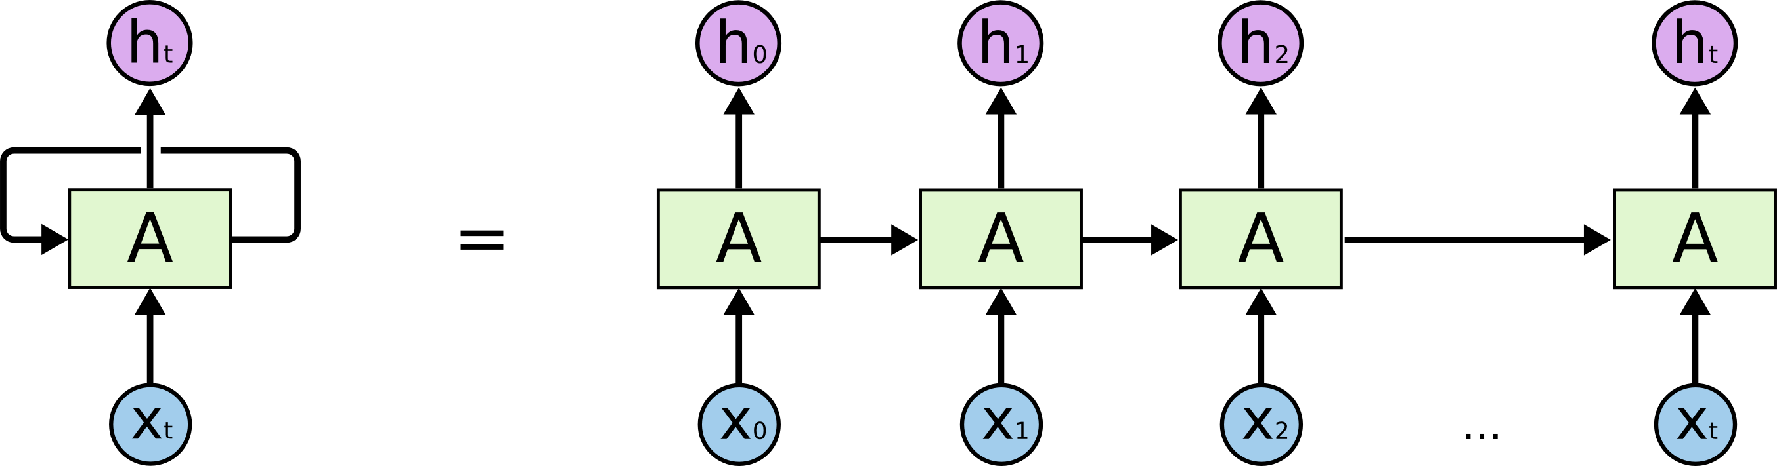
Recurrent Neural Network
Notes:
A recurrent neural network can be thought of as multiple copies of the same network layer.
%
Each layer has has input, a hidden state, and an output.
%
At each time step, the current layer’s hidden state and output are scaled and fed back to the network as the input to the next layer

Slide 10
Poem Generation with RNN
- A plume of smoke rises up into the evening sky of the Great Desert
大
漠
孤
烟
直
<END>
-Target Output
<SART>
大
漠
孤
烟
直
-Training Input
Notes:
https://www.tensorflow.org/api_docs/python/tf/nn/softmax_cross_entropy_with_logits
A plume of smoke rises up into the evening sky of the Great Desert, while the Yellow River dimmed as the setting sun goes down
Due to this recursive architecture, we can feed it with sequences of input and generate sequences of output.
%
That is, we’ll give the RNN a huge chunk of poems and ask it to model the probability distribution of the next character in the sequence given a sequence of previous characters.
%

Slide 11
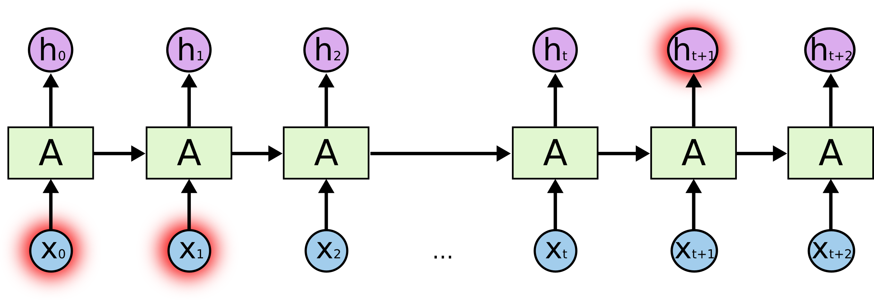

Long Short Term Memory Network
Notes:
Although RNN is flexibile on its input size and output size, it does have limitations.
When the gap between the relevant information and the place that the in formation needed is large , RNNs cannot handle such “long-term dependencies.” t
To solve this problem, we use a special kind of Recurrent neural network, An SLTM network also has a recursive structure, but the repeated cell has four network layers instead of one.
The sigmoid layer called the “forget gate layer. Each layer can decide what information we are going to throw away from the cell state.
The second layer decides what new new information we’re going to store in the cell state.
The last layer decide what we’re going to output.

Slide 12
Approaches
Approaches
Traditional
Genetic Algorithm
Machine Learning
Recurrent Neural Network
Generative Adversarial Networks

Slide 13



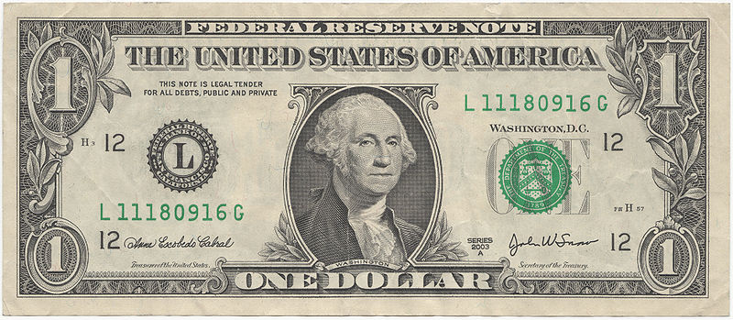
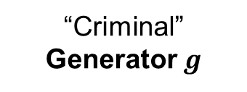
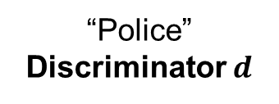
Generative Adversarial Networks (GANs)
Generative Model
Generated Sample
“Criminal”
Generator $g$
“Police”
Discriminator $d$
Training Sample
$$g^{∗}=\arg{\min_{g}{\max_{d}{v(g, d)}}}$$

Slide 14
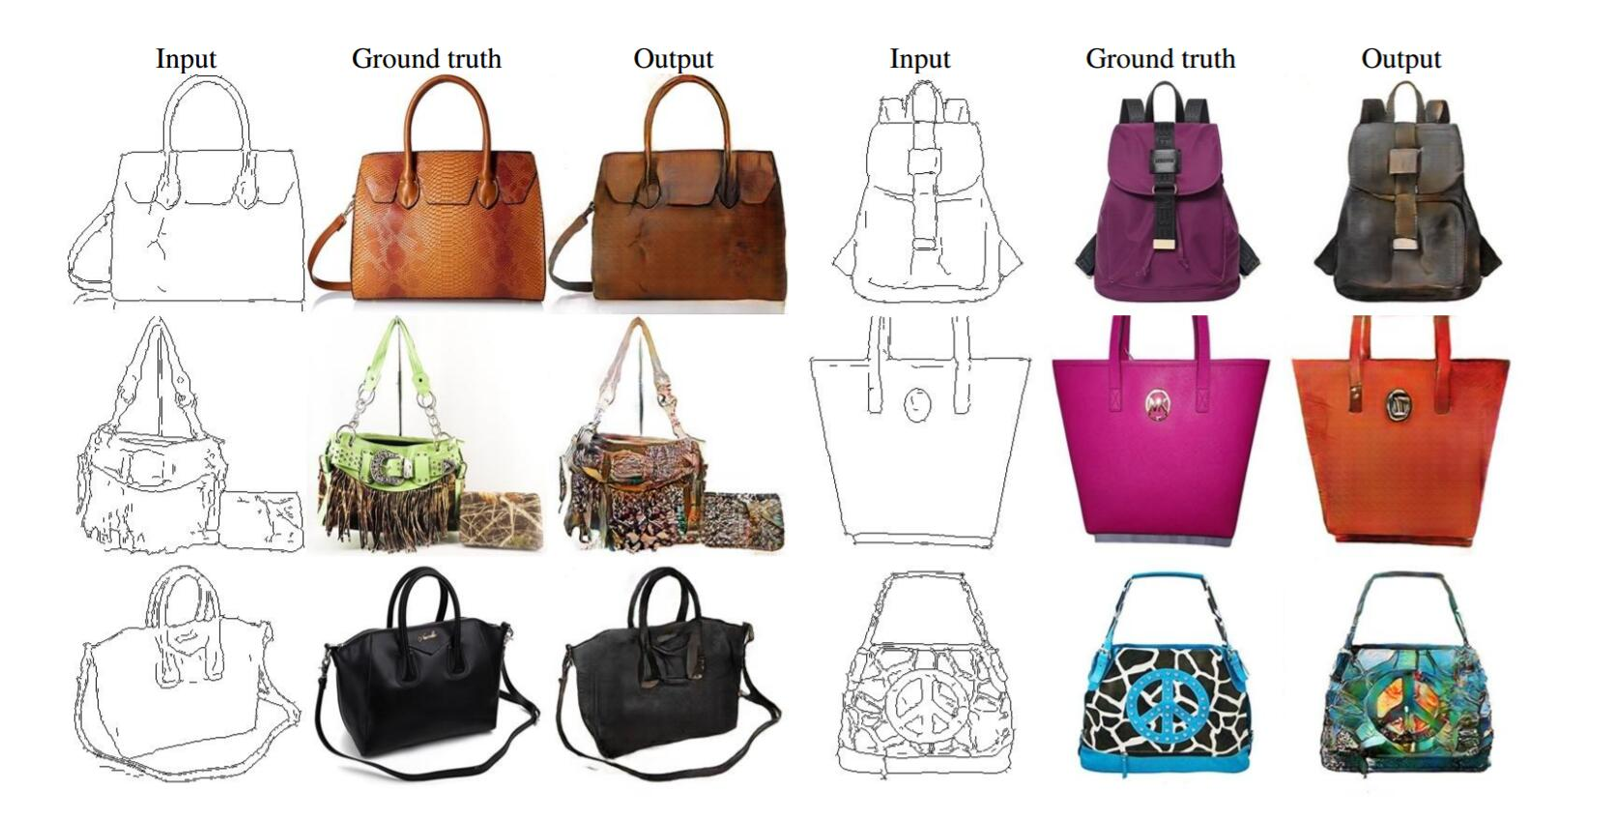
GANs
Isola, Phillip, et al. "Image-to-image translation with conditional adversarial networks." arXiv preprint arXiv:1611.07004 (2016).

Slide 15
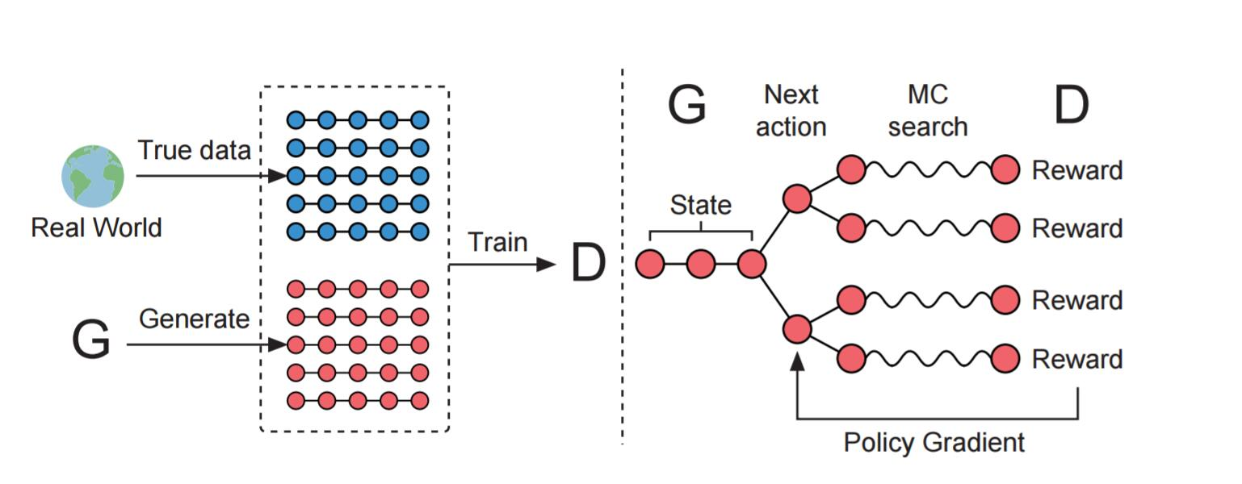
SeqGAN
Yu, Lantao, et al. "SeqGAN: sequence generative adversarial nets with policy gradient." AAAI 2017 (2017).

Slide 16
Genetic Algorithm Result: Huanxisha(浣溪沙）
别来已是二十年，It’s been twenty years since I left.
寒轻离别岸呜咽。At that moment, the river cried.
阳春归路转千年。Now it’s spring, and I don’t know when can I go back.
借问春寒梅旧否，It’s still cold, I asked whether plum blossom like before.
夜来去后雨轻扇。Rain comes without a sound during night.
佳人含笑立尊前。My loved one stand in front of me with smile.

Slide 17
Recurrent Neural Network Result： Huanxisha(浣溪沙）
溪头晚月砧残梦， The moonlight reflected from a brook lightened my withering dream.
沙巷桥边雨吹长。 The drizzle in the night blew to the small alley near a bridge.
桃花渡有故潭冰。 Ice from the old pond remains on the Peach Blossom ferry.
落叶斑斑飘雨后， Falling leaves were so colorful after that rain.
锦衣幽锁白山流， Brocade gowns were packed up while the White Mountain rivers were running off.
对酒难高雁远休。 I raise my goblet to the sky with a wild goose flying away.

Slide 18
Generative Adversarial Networks Result: Huanxisha（浣溪沙）
Able to learn Chinese words
Failed to catch hidden structure
一日凉秋报，
In one day, the fall season starts,
风云入故乡。
Wind and cloud enter my hometown.

Slide 19
Summary
Approaches | Pros | Cons
GA | Good property in structure and meanings | Pre-defined Constraints
RNN | No need of pre-defined rules | Performance depends on dataset
GAN | No need of pre-defined rules | Performance depends on dataset

Slide 20
Thank you

Slide 21
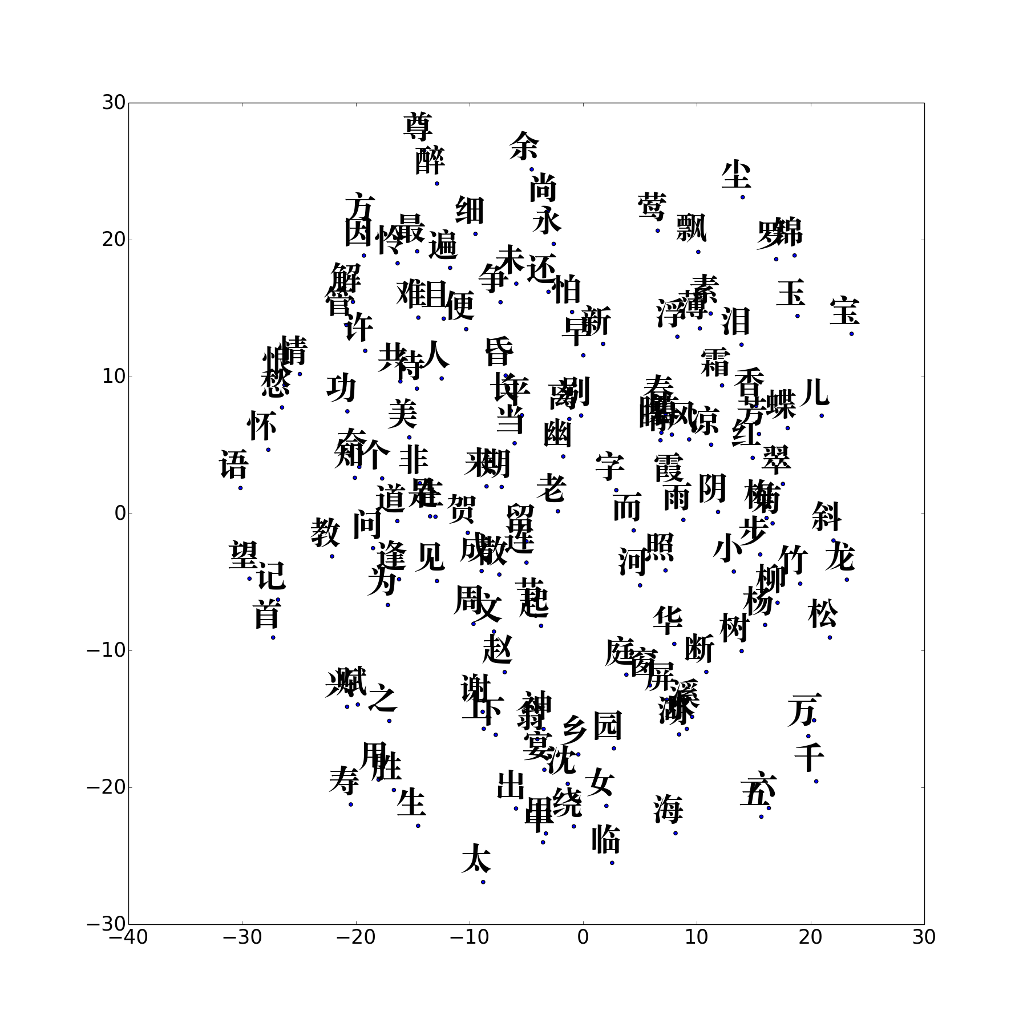
Word Embedding

Slide 22
Word Embedding
霞 glow
见 see
雨 rain
竹
bamboo
愁 sadness
柳
willow
闻 hear
情 feeling

Slide 23
Rhyme to Vector
床
前
明
月
光
,
chuang
qian
ming
yue
guang
ang
ian
ing
yue
uang
疑
是
地
上
霜
。
yi
shi
di
shang
shuang
yi
i
i
ang
uang

Slide 24
床
前
明
月
光
,
chuang
qian
ming
yue
guang
ang
ian
ing
yue
uang
疑
是
地
上
霜
。
yi
shi
di
shang
shuang
yi
i
i
ang
uang

Slide 25
Result
RNN Model: Huanxisha(浣溪沙)
深三歌,姬上酒，锦塘梅作画云娇。细成孤风莫浓秋。
三声烟,云幽丘，在楼海难调神游。福情千钓两两鱼.

Slide 26
- A plume of smoke rises up into the evening sky of the Great Desert
大
漠
孤
烟
直
<END>
-Target Output
<SART>
大
漠
孤
烟
直
-Training Input
Notes:
https://www.tensorflow.org/api_docs/python/tf/nn/softmax_cross_entropy_with_logits
A plume of smoke rises up into the evening sky of the Great Desert, while the Yellow River dimmed as the setting sun goes down
Due to this recursive architecture, we can feed it with sequences of input and generate sequences of output.
%
That is, we’ll give the RNN a huge chunk of poems and ask it to model the probability distribution of the next character in the sequence given a sequence of previous characters.
%

